Slide 1

KNOWLEDGE INSTITUTE OF TECHNOLOGY, SALEM – 637504
(Autonomous Institution)
MAP
2026
Second Review
PORTABLE PLANT CUTTER
Batch No.: 04
Club Name: SUSTAINABLE ENGINEERING CLUB
Team Members: GURU PRASANNA V , KARTHI VS ,KARTHICK SS ,BRAJEETH G ,THIRAGNATH J .
Full Affiliation: III Year , Knowledge Institute of Technology. Salem.
Name of the Mentor: MR.K.N.KARTHICK
Presentation Date: 28.01.2026

Slide 2
Table of Content
Solutions Generated (Customer / Industry Defined Problem)
Final Solution with Key Assumptions
Discussion with Customer / Industry for Solution Fit
Concept Development – MVP
Customer / Industry Validation
Further Plan to Execute
References

Slide 3
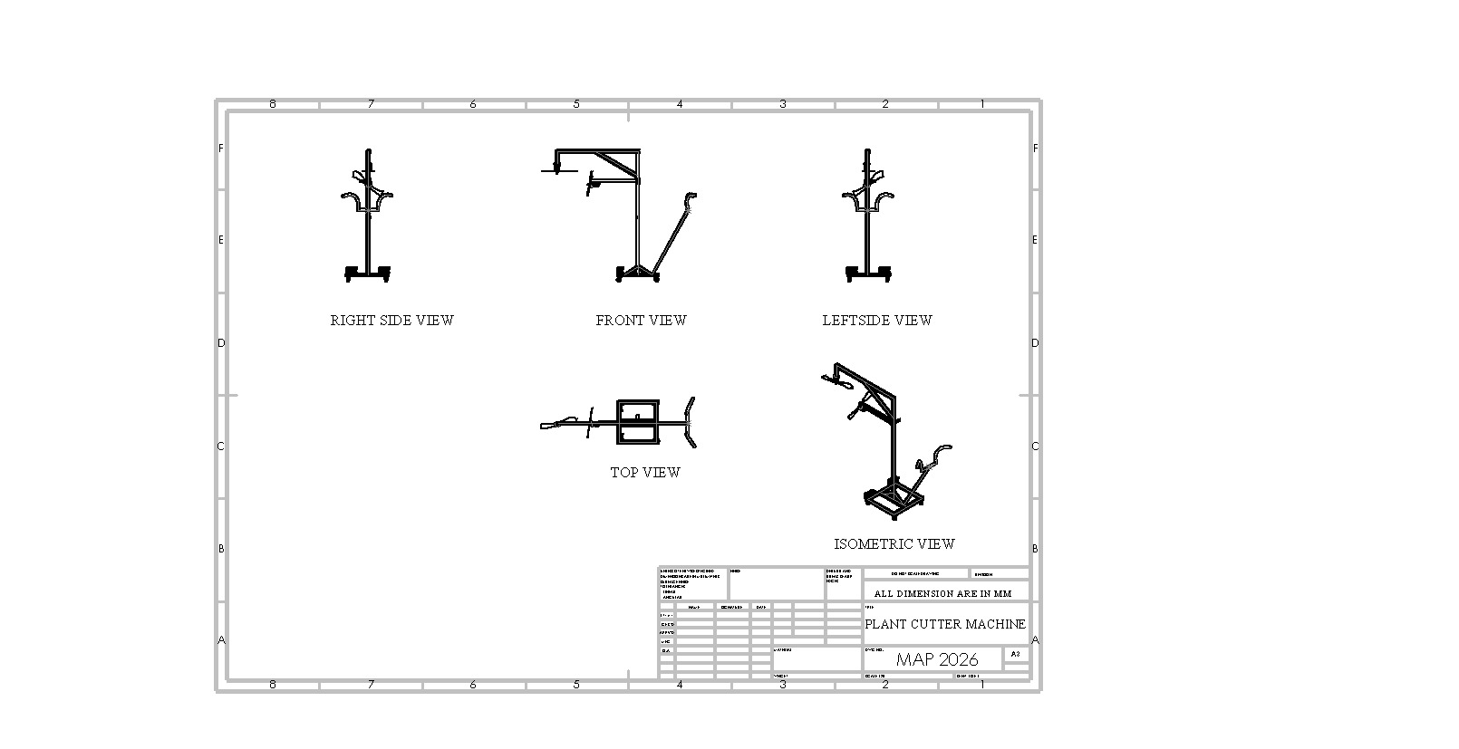
Solutions Generated (Customer/Industry Defined Problem)
Replace manual shears with dual DC Motor 775-driven rotating blades
Rigid rectangular steel frame with diagonal bracing for stability
Integrated 12V 7.5Ah rechargeable sealed lead-acid battery

Slide 4
Final Solution with Key Assumptions
COMPONENTS
Component | Specification
Motor | DC Motor 775 × 2
Blade Type | Counter-rotating dual blade
Power Supply | 12V, 9Ah SLA Battery
Frame Material | Mild Steel Rectangular Sections
Mobility | 4 Castor Wheels
Operation | Single Operator Push Control
Control | ON/OFF Switch with Isolator

Slide 5
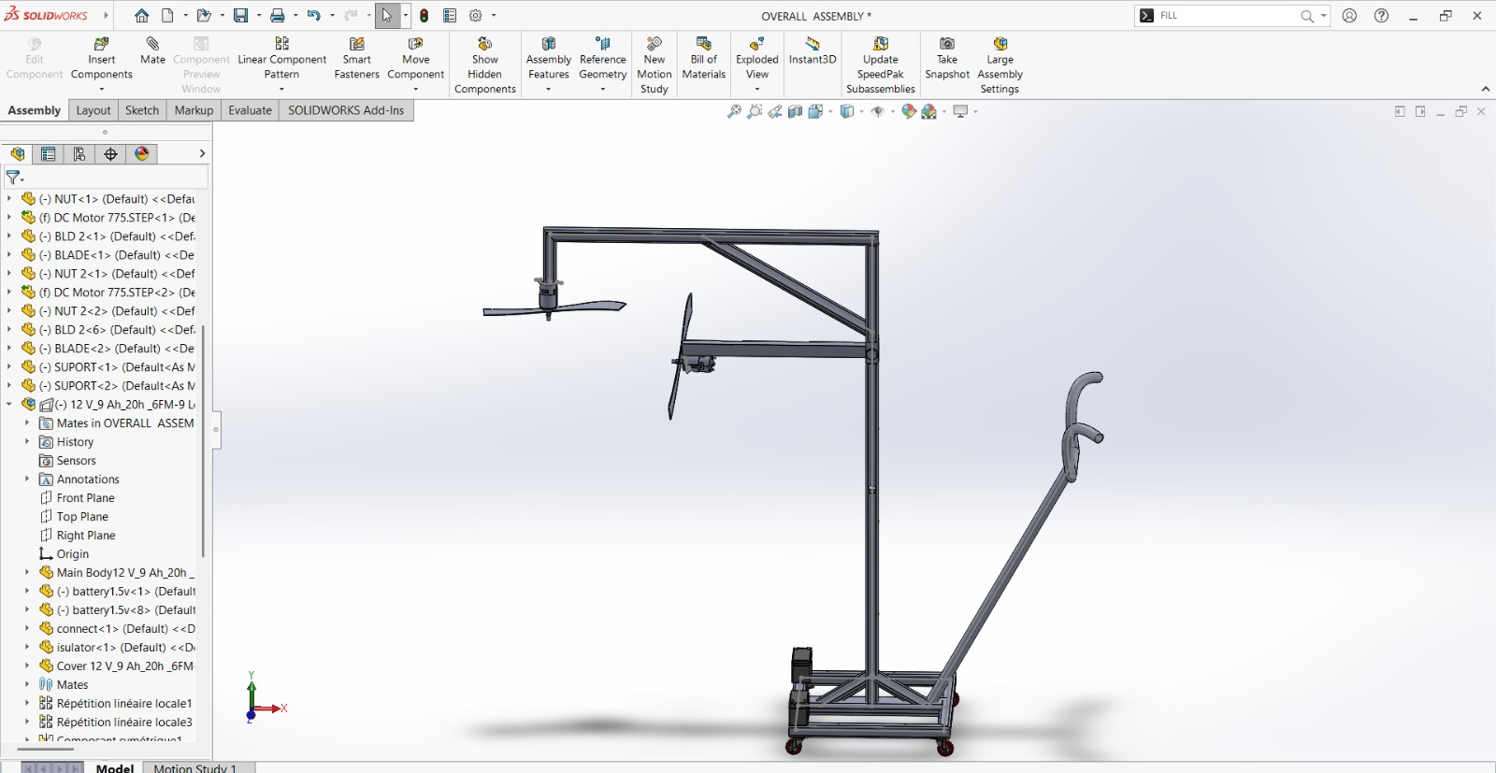
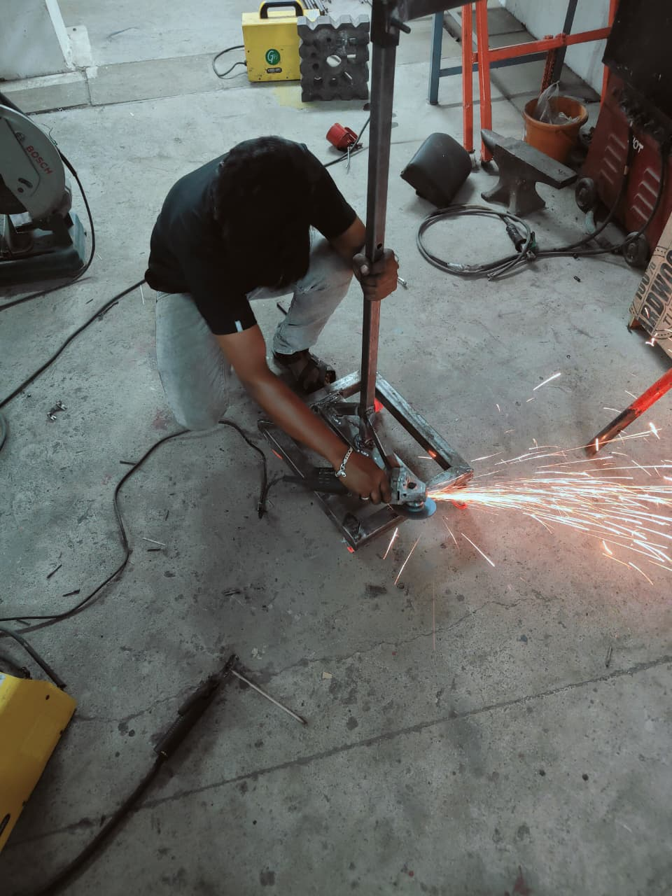
Concept Development – MVP

Slide 6
References
Reduce overall size of the collector for tabletop or mobile use
Optimize electromagnetic coil turns for lower power consumption
Improve dust guiding path using sheet metal funnel
Add removable metal dust tray for easy cleaning
Insulate electromagnetic coil properly
Provide earthing to metal body
Avoid overheating by limiting coil duty cycle
Ensure no spark generation (safe for metal dust)

